Slide 1
Computer Network

Slide 2
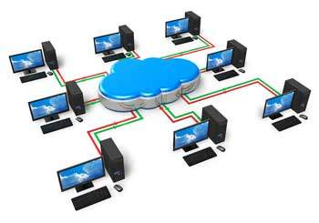
Computer Network

Slide 3
Computer network is a set of device or nodes connected through links
A node can be a computer, printers, or any other device capable of sending and receiving the data.
The links connecting the nodes are known as communication channel.
Features of computer network
Communication channel
Network provides us to communicate over the Network in a fast and efficient manner for ex: we can do, video conferencing, email messaging etc.
File sharing:
Computer network provides us to share the files with each other.

Slide 4
Software and hardware sharing:
We can install the applications on the main server . Therefor user can access the application centrally. So we do not need to install the software on every machine.
Hardware like printers can be accessible from any computer of our network.
Security:
Network allows the security by ensuring that the user has the right to access the certain files and applications.
Scalability:
Scalability means that we can add new components in the network. Network must be scalable so that we can extend the network by adding new devices but it decreases the speed of the connection and data of the transmission speed also decrease.
Reliablilty:
Computer network can use the alternative sources for the data communication in case of any hardware failure.

Slide 5
Types of Computer Network
LAN (Local area network)
MAN (Metropolitan Area Network)
WAN (Wide Area Network)
PAN (Personal Area Network)
CAN (Campus Area Network)

Slide 6
Local Area Network
Local Area Network is a group of computers connected to each other in a small area such as building, office.
LAN is used for connecting two or more personal computers through a communication medium such as twisted pair, coaxial cable, etc.
It is less costly as it is built with inexpensive hardware such as hubs, network adapters, and Ethernet cables.
The data is transferred at an extremely faster rate in Local Area Network.
Local Area Network provides higher security.
It offers bandwidth of 10- 100 mbps.

Slide 7
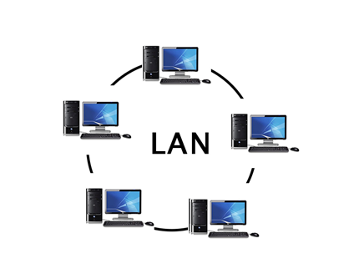
Distance range from 10m – 1km.

Slide 8
MAN(Metropolitan Area Network)
MAN covers a large geographic area by interconnecting a different LAN to form a large network. It spread over a metropolitan area such as within a city.
Government agencies uses MAN to connect the citizens and private industries.
It uses cables or wireless communication
Distance range is not more than 10km
The best example of MAN is the cable television available in many cities.

Slide 9
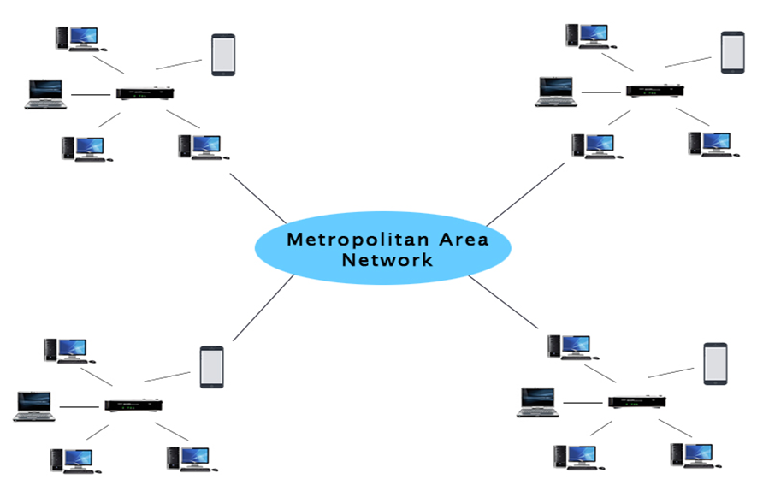

Slide 10
WAN (Wide Area Network)
Wide area network is a network that extends over a large geographical area such as states or countries.
Wide area network is not limited to a single location but it spans over a large geographical area through am telephone line,fiber optic cable or satellite links.
The internet is the one of the biggest WAN in the world.
Wide are network is widely used in the field of Business, government and education.

Slide 11
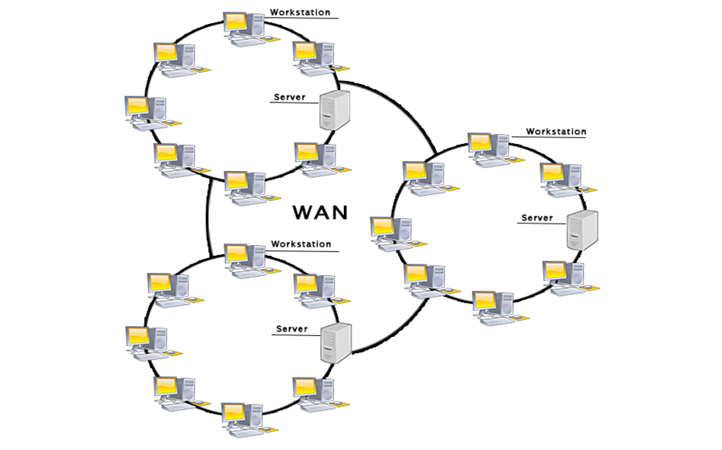

Slide 12
PAN(Personal Area Network)
Personal Area Network is a network arranged within an individual person, typically within a range of 10 meters.
Personal Area Network is used for connecting the computer devices of personal use is known as Personal Area Network.
Thomas Zimmerman was the first research scientist to bring the idea of the Personal Area Network.
Personal Area Network covers an area of 30 feet.
Personal computer devices that are used to develop the personal area network are the laptop, mobile phones, media player and play stations.

Slide 13
CAM(Campus Area Network)
A campus area network known as (CAN) is used to inter-connect networks in limited geographical locality like university campus, military bases, or organizational campuses etc.
CANs are smaller than metropolitan area networks (MAN) and wide area networks (WAN),

Slide 14
Types of communication Channel
Transmission Mode
Transmission Mode
Simplex ( Unidirectional)
Full-Duplex (Bi-directional)
Half-Duplex (Bi-directional)

Slide 15
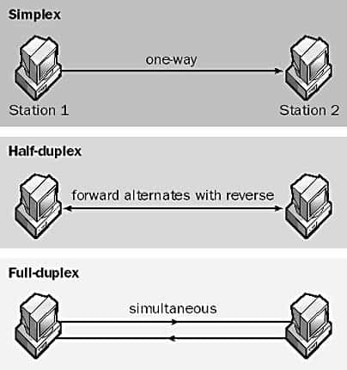
Simplex Example:
the radio or tv
Duplex Example:
Telephone system
Half duplex:
walkie-talki

Slide 16
Types of Network topologies
(Structure of Network)
Network topology is the way a network is arranged, including the physical or logical description of how links and nodes are set up to relate to each other. In other words, the arrangement of a network which comprises of nodes and connecting lines via sender and receiver is referred as network topology
BUS
RING
STAR
TREE (combines the characteristics of bus topology and star topology )
MESH
HYBRID

Slide 17
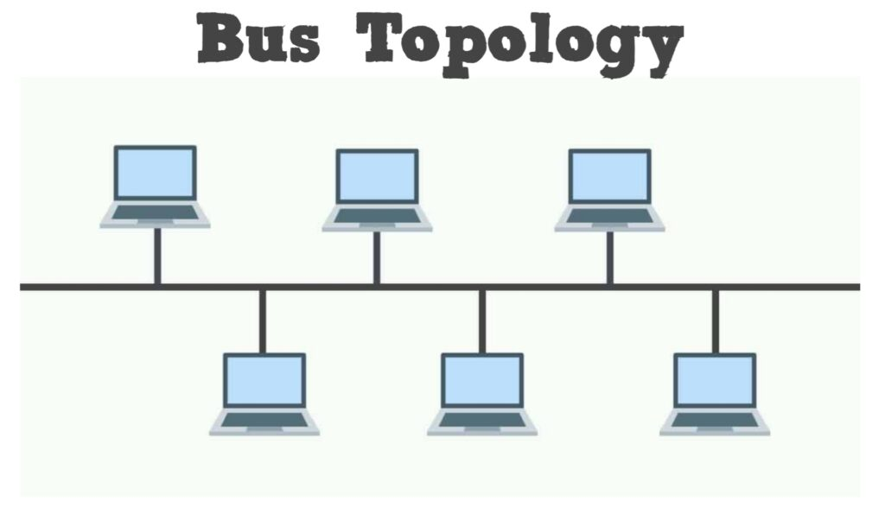
BUS Topology:
The bus topology is design in such a way that all the stations are connected through a single cable known as backbone cable.
Each node is either connected to the backbone cable by drop or directly connected to the back bone cable.
When a node wants to send a message over the network, it puts a message over a network. All the station available in the network will receive the message whether it has been addressed or not.
The configuration of bus topology is quite simpler than as compared to other topologies.

Slide 18
Advantage:
Low cost cable:
In bus topology nodes are directly connected to the cable without passing through hub. Therefore the initial cost of installation is low.
Moderate data speed:
Coaxial or twisted pair cable is used in bus-based network that support up to 10 mbps.
Limited failure:
Failure in one node will not have any effect on other nodes.

Slide 19
Disadvantage:
Extensive Cabling:
Bus topology is quite simpler, but still it requires a lot of cabling.
Difficult troubleshooting
It require specialized test equipment to determine the cable fault. If any fault in cable then it would disrupt the communication for all the node.
Single interference
If two nodes send a message simultaneously, then the signals of both the nodes collide with each other.
Adding the new device to the network would slow down the n/w.

Slide 20
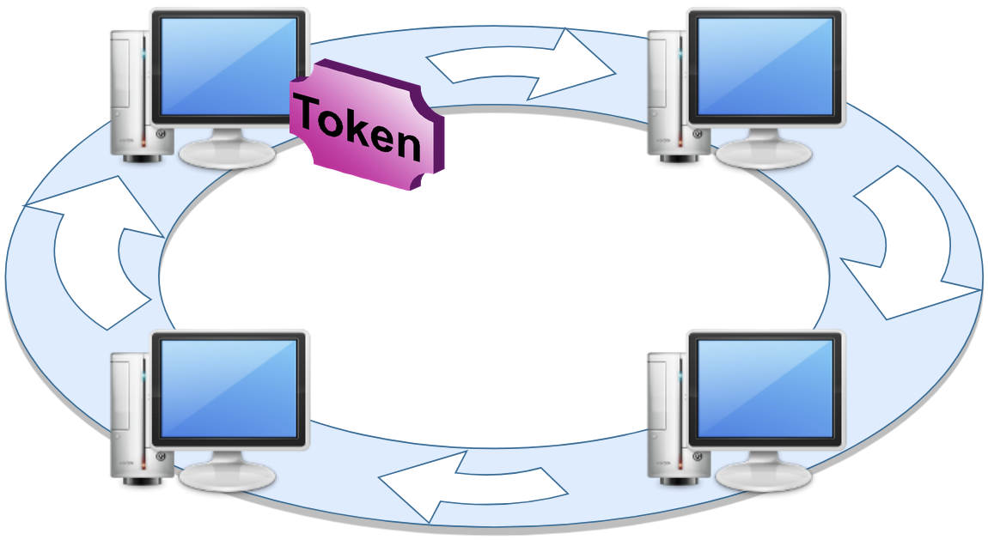
RING TOPOLOGY:
-Ring topology like a bus topology, but
with connected ends
-The data flows in one direction that it is
Unidirectional.
-the data flows in a single loop continuously
known as endless loop.
It has no terminated ends. Ie. Each node is connected to other node and having no termination point.
The data in ring topology flows in clockwise direction.
The most common access method of ring topology is token passing.
Token is the frame that circulates around the network.

Slide 21
Advantage of ring topology:
Network Management:
Faulty device can be removed from the network without bringing the network down.
Product Availability:
Many hardware and software tools for network operation and monitoring are available.
Cost:
Twisted pair cabling is inexpensive and easily available .therefore, the installation cost is very easy.

Slide 22
Disadvantage:
Difficult troubleshooting:
It requires specialized test equipment to determine the cable faults. If any fault occurs in the cable, then it would disrupt the communication for all the nodes.
Failure:
The breakdown in one station leads to the failure of the overall network.
Reconfiguration difficult:
Adding new devices to the network would slow down the network.
Delay:
Communication delay is directly proportional to the number of nodes. Adding new devices increases the communication delay.

Slide 23
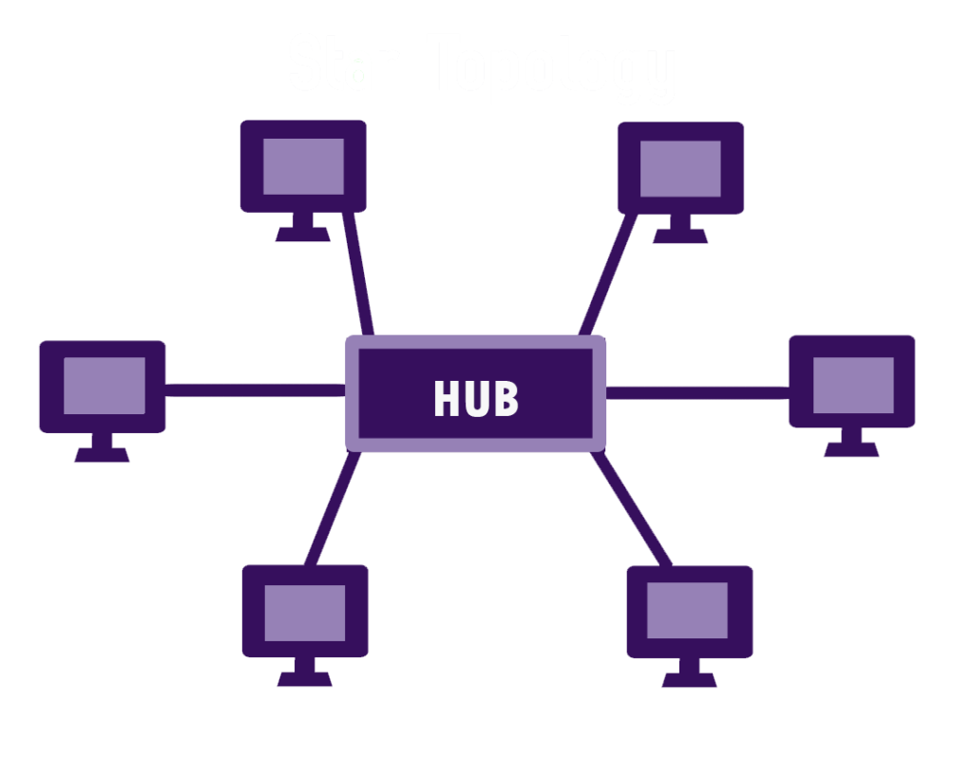
Star topology:
Star topology is an arrangement of the network
Which every node is connected to the central
Hub, switch or a central computer.
Central computer may be a server and
The attached to the server is known as clients.
Coaxial cable or RJ45cables are used to connect
the computers.
Hubs and switches are mainly uses as connecting devices in a physical star topology.

Slide 24
Advantages:
Efficient troubleshooting:
Troubleshooting is quite efficient in a star topology as compared to bus
Topology, the manager has to inspect the kilometers of cable. In the star topology all the station are connected to the centralized network.
Therefore the network administrator has to go to the single station to troubleshoot the problem.
Limited Failure:
As each station is connected to the central hub with its own cable, therefore failure in one cable will not affect the entire network.
Easily expandable:
It is easily expandable as new station can be added to the open ports on the hub.

Slide 25
High data Speed:
It support bandwidth of approx. 100mbps. Ethernet 100 Base T is one of the most popular star topology network.
Cost effective:
Star topology networks are cost-effective as it uses inexpensive coaxial cable.
Disadvantage:
Central point of Failure:
If the central hub or switch goes down then all the connected nodes will not be able to communicate with each other.

Slide 26
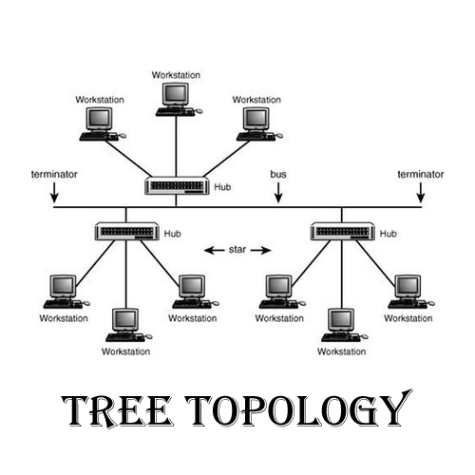
Tree topology:
Tree topology mainly combines the
characteristics of bus topology and star
topology.
All the computer are connected with
each other in hierarchical fashion.
There is only one path exists between
two nodes for data communication.

Slide 27
Advantage :
Easy expandable:
We can add the new device to the existing network.
Easy manageable:
In tree topology, the whole network is divided into segments know as star network which can be easily managed and maintained.
Error detection:
Error detection and error correction are very easy like star and bus topology.
Limited failure
The breakdown in one station does not affect the entire network.

Slide 28
Disadvantage
High Cost:
Devices required for broad band transmission are very high
Failure:
A tree topology mainly relies on main bus cable and failure in main bus cable will damage the overall network.

Slide 29
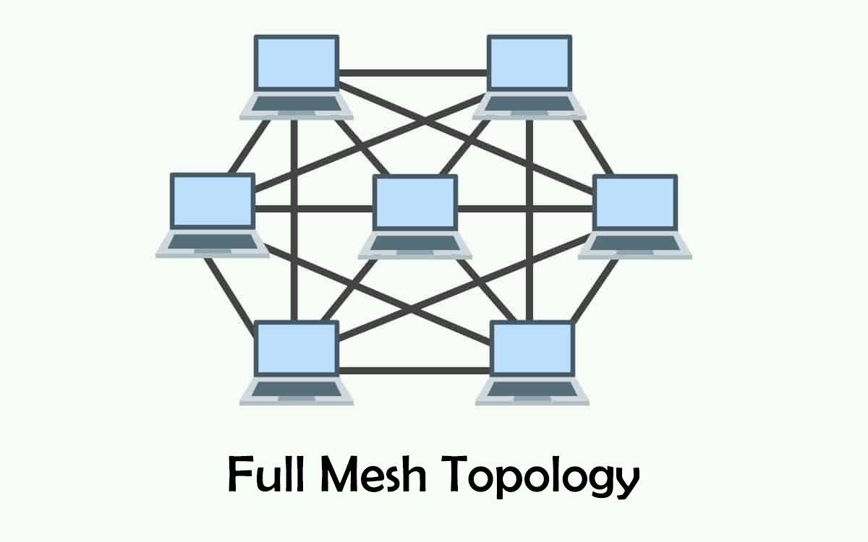
Mesh topology:
Mesh topology is an arrangement of the network in which computer are interconnected with each other
Through various connections.
There are multiple path from one
computer to another computer.
It does not contain the switch , hub
or any central computer which act
As central point of communication.
The internet is an example of mesh topology.
Mesh topology is mainly used for wireless
network.
Mesh topology can be formed by using
the formula
Number of cables = (n*(n-1)/2)
Where n represents the number of nodes represent in network.

Slide 30
Mesh topology is divided into two categories.
Fully connected mesh topology → Each computer is connected to all the computer available in the network.
Partially connected mesh topology → In this not all but certain computer are connected to those computers with which they communicate frequently.
Advantages:
Reliable: The mesh topology network are very reliable as if any link breakdown will not affect the communication between computer.
Fast communication: Communication is very fast between the nodes.
Easier Reconfiguration :Adding an new device would not effect the communication between other devices.

Slide 31
Disadvantage:
Cost:
Mesh topology contains large number of connected device such as a router and more transmission media than other topology.
Management:
Mesh topology is very larger and difficult to maintain and manage.

Slide 32
Hybrid topology:
The combination of different topologies is known as hybrid topology.
When two or more topologies are connected together as hybrid topology and if similar topology are connected with each other will not result in hybrid topology, for example: if there exist a ring topology in one branch of everest college and bus topology in another branch of Everest connecting these topologies will result in hybrid topology.
Advantage:
Reliable: If a fault occurs in any part of the network will not affect the functioning of the rest of the network.
Scalable: Size of network can be easily expanded by adding new devices without affecting the functionality if the existing network.

Slide 33
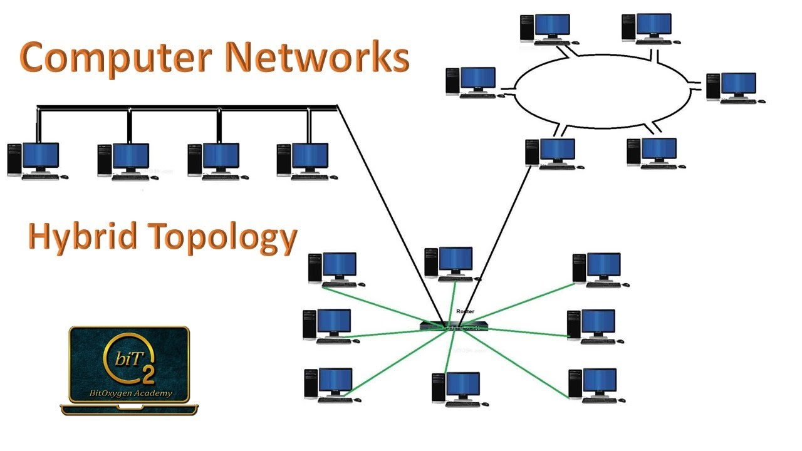

Slide 34
Flexible: This topology is very flexible as it can be designs according to the requirement of the organizations.
Effective: Hybrid topology is very effective as it can be designed in such a way that the strength of the network is maximized and weakness if the network is minimized.
Disadvantage:
Complex design: It is very difficult to design the architecture.
Costly: The infrastructure cos is very high as a hybrid network requires a lots of cabling, network device etc.

Slide 35
Network Architecture
Computer Network Architecture is defined as the physical and logical design of the software, hardware, protocols, and media of the transmission of data. Simply we can say that how computers are organized and how tasks are allocated to the computer.
The two types of network architectures are used:
Peer-To-Peer network
Client/Server network

Slide 36
Peer-To-Peer network
Peer-To-Peer network is a network in which all the computers are linked together with equal privilege and responsibilities for processing the data.
Peer-To-Peer network is useful for small environments, usually up to 10 computers.
Peer-To-Peer network has no dedicated server.
Special permissions are assigned to each computer for sharing the resources, but this can lead to a problem if the computer with the resource is down.

Slide 37
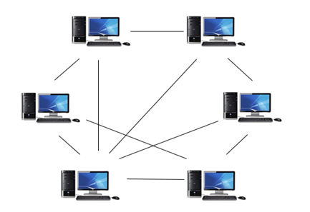
Peer to peer network

Slide 38
Advantages Of Peer-To-Peer Network:
It is less costly as it does not contain any dedicated server.
If one computer stops working but, other computers will not stop working.
It is easy to set up and maintain as each computer manages itself.
Disadvantages Of Peer-To-Peer Network:
In the case of Peer-To-Peer network, it does not contain the centralized system . Therefore, it cannot back up the data as the data is different in different locations.
It has a security issue as the device is managed itself.

Slide 39
Client/Server Network
Client/Server network is a network model designed for the end users called clients, to access the resources such as songs, video, etc. from a central computer known as Server.
The central controller is known as a server while all other computers in the network are called clients.
A server performs all the major operations such as security and network management.
A server is responsible for managing all the resources such as files, directories, printer, etc.
All the clients communicate with each other through a server. For example, if client1 wants to send some data to client 2, then it first sends the request to the server for the permission. The server sends the response to the client 1 to initiate its communication with the client 2.

Slide 40
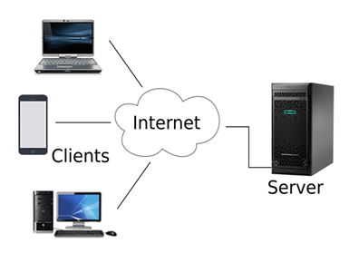
Client/Server

Slide 41
Advantages Of Client/Server network:
A Client/Server network contains the centralized system. Therefore we can back up the data easily.
A Client/Server network has a dedicated server that improves the overall performance of the whole system.
Security is better in Client/Server network as a single server administers the shared resources.
It also increases the speed of the sharing resources.
Disadvantages Of Client/Server network:
Client/Server network is expensive as it requires the server with large memory.
A server has a Network Operating System(NOS) to provide the resources to the clients, but the cost of NOS is very high.
It requires a dedicated network administrator to manage all the resources.

Slide 42
OSI reference model
OSI stands for Open Systems Interconnection. It has been developed by ISO – ‘International Organization for Standardization‘, in the year 1984. It is a 7 layer architecture with each layer having specific functionality to perform. All these 7 layers work collaboratively to transmit the data from one person to another across the globe.

Slide 43
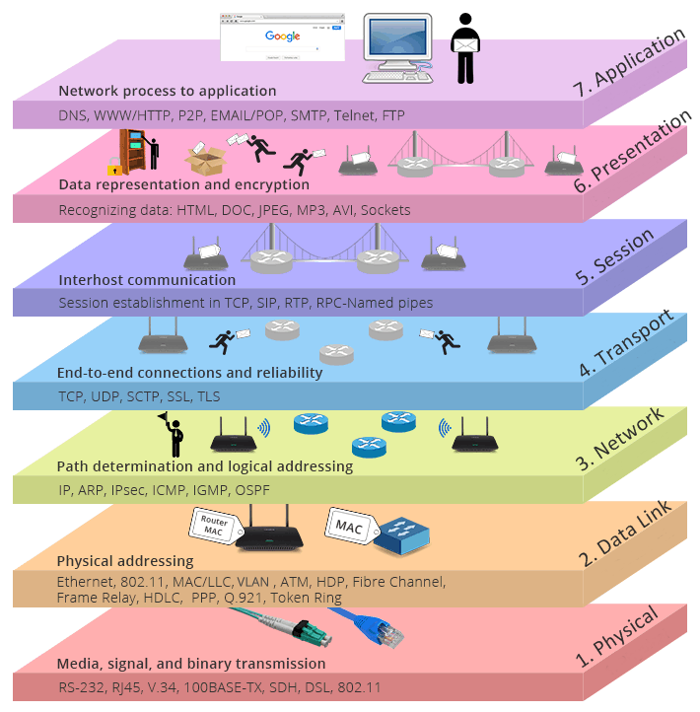
Software layers
Heart of OSI
segmentation
packets
Hardware layers
frame
bits

Slide 44

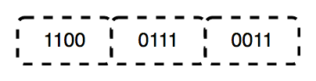
1. Physical Layer (Layer 1) :
The lowest layer of the OSI reference model is the physical layer.
It is responsible for the actual physical connection between the devices.
The physical layer contains information in the form of bits.
It is responsible for transmitting individual bits from one node to the next. When receiving data, this layer will get the signal received and convert it into 0s and 1s and send them to the Data Link layer, which will put the frame back together.

Slide 45
The functions of the physical layer are :
Bit synchronization: The physical layer provides the synchronization of the bits by providing a clock. This clock controls both sender and receiver thus providing synchronization at bit level.
Bit rate control: The Physical layer also defines the transmission rate i.e. the number of bits sent per second.
Physical topologies: Physical layer specifies the way in which the different, devices/nodes are arranged in a network i.e. bus, star, or mesh topology.
Transmission mode: Physical layer also defines the way in which the data flows between the two connected devices. The various transmission modes possible are Simplex, half-duplex and full-duplex.
* Hub, Repeater, Modem, Cables are Physical Layer devices. ** Network Layer, Data Link Layer, and Physical Layer are also known as Lower Layers or Hardware Layers.

Slide 46
2. Data Link Layer (DLL) (Layer 2) :
The data link layer is responsible for the node-to-node delivery of the message. The main function of this layer is to make sure data transfer is error-free from one node to another, over the physical layer. When a packet arrives in a network, it is the responsibility of DLL to transmit it to the Host using its MAC address. Data Link Layer is divided into two sublayers:
Logical Link Control (LLC)
Media Access Control (MAC)
The packet received from the Network layer is further divided into frames depending on the frame size of NIC(Network Interface Card). DLL also encapsulates Sender and Receiver’s MAC address in the header.
The Receiver’s MAC address is obtained by placing an ARP(Address Resolution Protocol) request onto the wire asking “Who has that IP address?” and the destination host will reply with its MAC address.

Slide 47
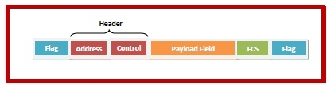


Fields of a Data Link Layer Frame
A data link layer frame has the following parts:
Frame Header: It contains the source and the destination addresses of the frame and the control bytes.
Payload field: It contains the message to be delivered.
Trailer: It contains the error detection and error correction bits. It is also called a Frame Check Sequence (FCS).
Flag: Two flag at the two ends mark the beginning and the end of the frame.
MAC 1
MAC 2
Frame

Slide 48
The functions of the Data Link layer are :
Framing: Framing is a function of the data link layer. It provides a way for a sender to transmit a set of bits that are meaningful to the receiver. This can be accomplished by attaching special bit patterns to the beginning and end of the frame.
Physical addressing: After creating frames, the Data link layer adds physical addresses (MAC address) of the sender and/or receiver in the header of each frame.
Error control: Data link layer provides the mechanism of error control in which it detects and retransmits damaged or lost frames.
Flow Control: The data rate must be constant on both sides else the data may get corrupted thus, flow control coordinates the amount of data that can be sent before receiving acknowledgement.
Access control: When a single communication channel is shared by multiple devices, the MAC sub-layer of the data link layer helps to determine which device has control over the channel at a given time.
* Packet in Data Link layer is referred to as Frame. ** Data Link layer is handled by the NIC (Network Interface Card) and device drivers of host machines. *** Switch & Bridge are Data Link Layer devices.

Slide 49
Network layer:
Network layer is responsible for data transmission from one network to another.
The network layer is responsible for receiving frames from the data link layer,
and delivering them to their intended destinations among based on the addresses contained inside the frame.
It also takes care of packet routing i.e. selection of the shortest path to transmit the packet, from the number of routes available. The sender & receiver’s IP addresses are placed in the header by the network layer.
Functions of network layer
Routing: The network layer protocols determine which route is suitable from source to destination. This function of the network layer is known as routing.
Logical Addressing: In order to identify each device on internetwork uniquely, the network layer defines an addressing scheme. The sender & receiver’s IP addresses are placed in the header by the network layer. Such an address distinguishes each device uniquely and universally.
*Segment in Network layer is referred to as Packet.
** Network layer is implemented by networking devices such as routers.

Slide 50


Transport Layer:
Transport layer is responsible for end-to-end connectivity. It is also known as the heart of OSI layer.
Following task are performed by OSI layer
Identifying services
Multiplexing and DE multiplexing
Segmentation
Sequencing and reassembling
Error correction
Flow control
How are you ?
How
are
you
?
Segmentation
How are you ?
How
you
are
?
Sequencing and reassembling using number

Slide 51
Session Layer
Session layer is responsible for
establishing,
maintaining and
terminating session
Presentation Layer :
The presentation layer is also called the Translation layer. The data from the application layer is extracted here and manipulated as per the required format to transmit over the network. The functions of the presentation layer are :
Translation: For example, ASCII to EBCDIC.
Encryption/ Decryption: Data encryption translates the data into another form or code. The encrypted data is known as the ciphertext and the decrypted data is known as plain text. A key value is used for encrypting as well as decrypting data.
Compression: Reduces the number of bits that need to be transmitted on the network.

Slide 52
Application Layer:
Application layer is responsible for providing Networking Services to the user. It is also known as desktop Layer. Identification of services is done using Port Numbers.
The functions of the Application layer are :
Network Virtual Terminal
FTAM-File transfer access and management
Mail Services
Directory Services

Slide 53
It was developed by the DoD (Department of Defense) in the 1960s. It is named after the two main protocols that are used in the model, namely, TCP and IP. TCP stands for Transmission Control Protocol and IP stands for Internet Protocol.
Support client-server and peer-to-peer.
TCP/IP

Slide 54
Application Layer
Transport Layer (Host-to-Host)
Network Layer
Data link layer
Physical layer
Application Layer
Presentation Layer
Session Layer
Transport Layer
Network Layer
Datalink Layer
Physical layer
Application Layer
Transport Layer (Host-to-Host)
Internet Layer
Network Access Layer
TCP/IP
OSI
TCP/IP

Slide 55
Network Access Layer –
This layer corresponds to the combination of Data Link Layer and Physical Layer of the OSI model.
It looks out for hardware addressing and the protocols present in this layer allows for the physical transmission of data.
Data processes in the form of frames and bits.
This layer concerned about the physical transmission of data.
Internet Layer -
This layer parallels the functions of OSI’s Network layer.
It defines the protocols which are responsible for logical transmission of data over the entire network. The main protocols residing at this layer are :

Slide 56
IP – stands for Internet Protocol and it is responsible for delivering packets from the source host to the destination host by looking at the IP addresses in the packet headers. IP has 2 versions: IPv4 and IPv6. IPv4 is the one that most of the websites are using currently. But IPv6 is growing as the number of IPv4 addresses are limited in number when compared to the number of users.
ICMP – stands for Internet Control Message Protocol. It is encapsulated within IP datagrams and is responsible for providing hosts with information about network problems.
ARP – stands for Address Resolution Protocol. Its job is to find the hardware address of a host from a known IP address. ARP has several types: Reverse ARP, Proxy ARP, Gratuitous ARP and Inverse ARP.

Slide 57
Host-to-Host Layer –
This layer is analogous to the transport layer of the OSI model. It is responsible for end-to-end communication and error-free delivery of data. It shields the upper-layer applications from the complexities of data. The two main protocols present in this layer are :
Transmission Control Protocol (TCP) – It is known to provide reliable and error-free communication between end systems. It performs sequencing and segmentation of data. It also has acknowledgment feature and controls the flow of the data through flow control mechanism. It is a very effective protocol but has a lot of overhead due to such features. Increased overhead leads to increased cost.
User Datagram Protocol (UDP) – On the other hand does not provide any such features. It is the go-to protocol if your application does not require reliable transport as it is very cost-effective. Unlike TCP, which is connection-oriented protocol, UDP is connectionless.

Slide 58
Application Layer
An application layer is the topmost layer in the TCP/IP model.
It is responsible for handling high-level protocols, issues of representation.
This layer allows the user to interact with the application.
When one application layer protocol wants to communicate with another application layer, it forwards its data to the transport layer.
There is an ambiguity occurs in the application layer. Every application cannot be placed inside the application layer except those who interact with the communication system. For example: text editor cannot be considered in application layer while web browser using HTTP protocol to interact with the network where HTTP protocol is an application layer protocol.
Following are the main protocols used in the application layer:
HTTP: HTTP stands for Hypertext transfer protocol. This protocol allows us to access the data over the world wide web. It transfers the data in the form of plain text, audio, video. It is known as a Hypertext transfer protocol as it has the efficiency to use in a hypertext environment where there are rapid jumps from one document to another.
SNMP: SNMP stands for Simple Network Management Protocol. It is a framework used for managing the devices on the internet by using the TCP/IP protocol suite.

Slide 59
SMTP: SMTP stands for Simple mail transfer protocol. The TCP/IP protocol that supports the e-mail is known as a Simple mail transfer protocol. This protocol is used to send the data to another e-mail address.
DNS: DNS stands for Domain Name System. An IP address is used to identify the connection of a host to the internet uniquely. But, people prefer to use the names instead of addresses. Therefore, the system that maps the name to the address is known as Domain Name System.
FTP: FTP stands for File Transfer Protocol. FTP is a standard internet protocol used for transmitting the files from one computer to another computer.

Slide 60
Difference between OSI Model and TCP/IP Model
OSI Layer | TCP/IP
It has 7 layers | It has 4 layers
It is a reference model | It is implementation model
It has separate presentation and session layer | Presentation and session layer both combined in a Application layer
It is developed by ISO (International organization for standardization) | It is developed by DOD (department of defense)
Network Layer is both Connection Oriented and Connection less. | Network Layer is Connection less.
OSI uses the network layer to define routing standards and protocols | Internet layer uses for the routing purpose.

Slide 61
OSI | TCP/IP
In OSI model the transport layer guarantees the delivery of packets. | In TCP/IP model the transport layer does not guarantees delivery of packets.
Model was developed before the development of protocol | Protocol were developed first then the model was developed
In the OSI model, the transport layer is only connection-oriented. | A layer of the TCP/IP model is both connection-oriented and connectionless
OSI model defines services, interfaces and protocols very clearly and makes clear distinction between them. It is protocol independent. | In TCP/IP, services, interfaces and protocols are not clearly separated. It is also protocol dependent.

Slide 62
Similarities OSI reference model and TCP/IP:
Both are logical models.
Both define standards for networking.
Both provide a framework for creating and implementing networking standards and devices.
Both divide the network communication process into layers.
In both models, a single layer defines a particular functionality and sets standards for that functionality only.
Both models allow a manufacturer to make devices and network components that can coexist and work with the devices and components made by other manufacturers.
Both models simplify the troubleshooting process by dividing complex functions into simpler components.

Slide 63
Connection Oriented Services:
A connection-oriented service needs an established connection between peers before data can be sent between the connected terminals. This method is often called a "reliable" network service. This handles real-time traffic more efficiently than connectionless protocols because data arrives in the same order as it was sent. Connection-oriented protocols are also less error-prone. There is a sequence of operation to be followed by the users of connection-oriented service. These are:
Connection is established.
Information is sent.
3. Connection is released.

Slide 64
In connection-oriented service, we have to establish a connection before starting the communication. When connection is established, we send the message or the information and then we release the connection. Example of connection oriented is TCP (Transmission Control Protocol) protocol.

Slide 65
Connection less Services:
Connectionless service means that a terminal or node can send data packets to its destination without establishing a connection to the destination. A session connection between the sender and the receiver is not required, the sender just starts sending the data.
The message or datagram is sent without prior arrangement, which is less reliable but faster transaction than a connection-oriented service. This works because of error handling protocols, which allow for error correction like requesting retransmission. It is similar to the postal services, as it carries the full address where the message (letter) is to be carried. Each message is routed independently from source to destination. The order of message sent can be different from the order received. LANs are actually connectionless systems with each computer able to transmit data packets as soon as it can access the network. The Internet is a large connectionless packet network in which all packet delivery is handled by Internet providers.
Example of Connectionless service is UDP (User Datagram Protocol) protocol.

Slide 66
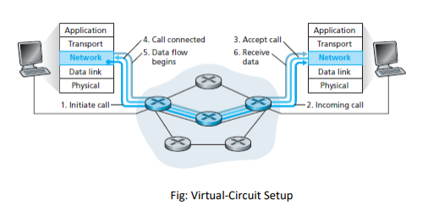

Slide 67
Connection oriented protocols:
Virtual Circuits:
A virtual circuit (VC) is a means of transporting data over a packet switched computer network in such a way that it appears as there is a dedicated physical layer link between the source and destination end systems of this data.
The network layer provides either a host-to-host connectionless service or a host-to-host connection service, but not both.
Computer networks that provide only a connection service at the network layer are called virtual-circuit (VC) networks.
A VC consists of:
(1) A path (that is, a series of links and routers) between the source and destination hosts,
(2) VC numbers, one number for each link along the path, and
(3) Entries in the forwarding table in each router along the path.

Slide 68
A packet belonging to a virtual circuit will carry a VC number in its header. Because a virtual circuit may have a different VC number on each link, each intervening router must replace the VC number of each traversing packet with a new VC number. The new VC number is obtained from the forwarding table.
There are three phases in a virtual circuit:
VC Setup
Data Transfer
VC Teardown

Slide 69
VC Setup: During this setup phase, the sending transport layer contacts the network layer, specifies the receiver’s address, and waits for the network to set up the VC. The network layer determines the path between sender and receiver, that is, the series of links and routers through which all packets of the VC will travel. The network layer also determines the VC number for each link along the path. Finally, the network layer adds an entry in the forwarding table in each router along the path. During VC setup, the network layer may also reserve resources (for example, bandwidth) along the path of the VC.
Data Transfer: As shown in the figure below, once the VC has been established, packets can begin to flow along the VC.
VC Teardown: This is initiated when the sender (or receiver) informs the network layer of its desire to terminate the VC. The network layer will then typically inform the end system on the other side of the network of the call termination and update the forwarding table sin each of the packet routers on the path to indicate that the VC no longer exists.

Slide 70
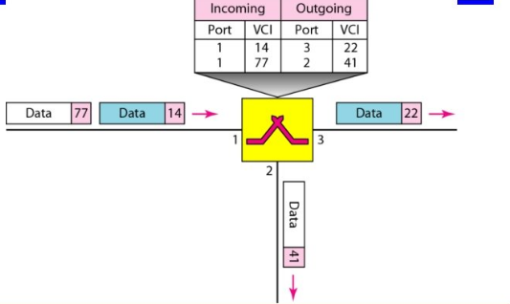

Slide 72
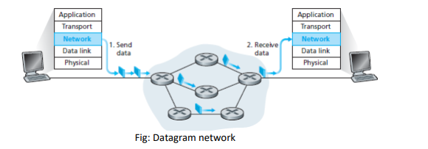
Connectionless Protocols: (Datagram)
The connectionless services at the network layer are called datagram networks. In a datagram network, each time an end system wants to send a packet, it stamps the packet with the address of the destination end system and then pops the packet into the network. As shown in Figure, there is no VC setup and routers do not maintain any VC state information (because there are no VCs).

Slide 73
Virtual circuit | Datagram
Bandwidth,Bus ,cpu ,buffer all things are reserved | Nothing is reserved
Same path used for all the packet | Packet takes different routes different path (may or may not)
Packet received in ordered | Out of order
Connection oriented | Connection less
costly | Not that much costly as compared to virtual circuit
Reliable(no losses of packets) | Not reliable(packets may be lost)

Slide 74
Internet
Internet is composed of the hundreds of thousands of interconnected network
A network is a group of connected, communicating devices such as computer and printers.
It uses standard internet protocol suite (TCP/IP) to connect billions of computer users worldwide.
It is set up by using cables such as optical fibers and other wireless and networking technologies.
At present, internet is the fastest mean of sending or exchanging information and data between computers across the world.

Slide 75
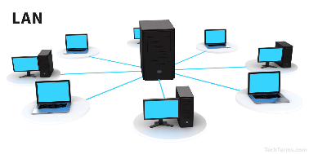

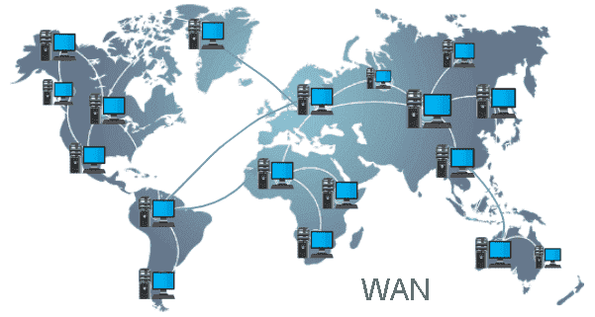
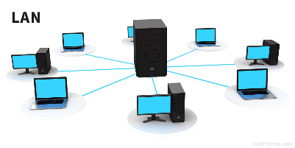


Slide 76
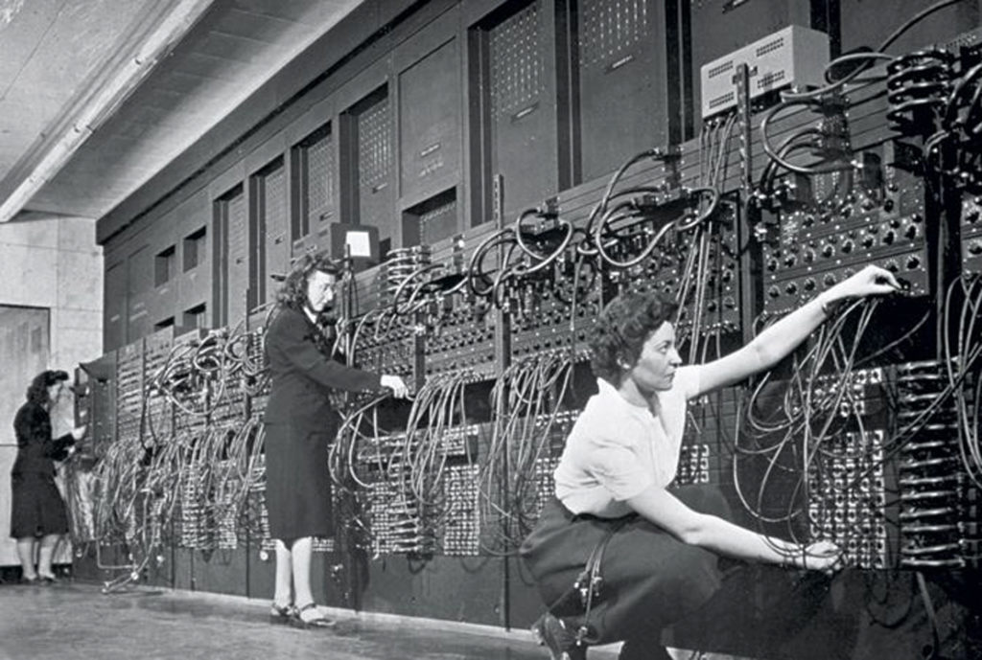
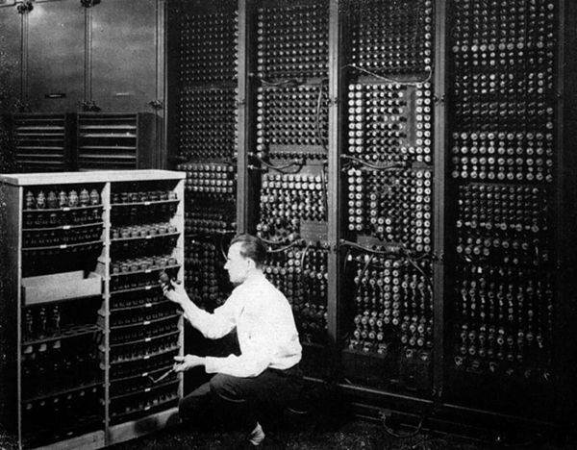
History of Internet
ENIAC(Electronic Numerical integrator and Computer)
Feb. 14,1946

Slide 77

Mid 1960s:
The Advanced Research Projects Agency (ARPA) in the Department of Defense (DOD) was interested in finding a way to connect computers together.
So that the researchers they funded could share their funded, thereby reducing costs and eliminating duplicating of effort.
By 1969 ARPANET
Four nodes, at the university of California at los Angels
(UCLA),the university at Santa Barbara(USCB),Standford research institute (SRI),and the university of Utah. Were c
onnected

Slide 78
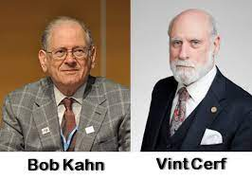
1972
Birth of Internet
Vint Cert Bob Kahn. Both of whom were part of the core ARPANET group, collaborated on what they called the internetting Project.
They wanted to link different networks together so that ahost on one network could communicate with a host on a second, different network.
They developed a hardware device named as
Gateway to connect different Network.
They develop TCP(Transmission Control Protocol)
Which splits into TCP and IP and then called
TCP/IP.

Slide 79
1981:CSNET(Computer Science Network )
It was developed by National Science foundation.
1983 ARPANET
-divided into two groups
MILNET for military user
ARPANET for non-military users

Slide 80
Internet Service Provider (ISP):
An Internet service provider (ISP) is an organization that provides services for accessing, using, or participating in the Internet. There are international service providers, national service providers, regional service providers, and local service providers. The Internet today is run by private companies, not the government. Figure below shows a conceptual (not geographic) view of the Internet.

Slide 81
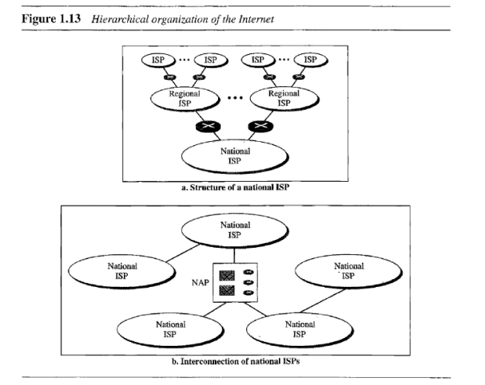

Slide 82
International Internet Service Providers
International service providers that connect nations together.
National Internet Service Providers
The national Internet service providers are backbone networks created and maintained by specialized companies. There are many national ISPs operating in Nepal; some of the most well-known are Worldlink, Subisu, Vianet. To provide connectivity between the end users, these backbone networks are connected by complex switching stations (normally run by a third party) called network access points (NAPs). Some national ISP networks are also connected to one another by private switching stations called peering points. These normally operate at a high data rate (up to 600 Mbps).

Slide 83
Regional Internet Service Providers
Regional internet service providers or regional ISPs are smaller ISPs that are connected to one or more national ISPs. They are at the third level of the hierarchy with a smaller data rate.
Local Internet Service Providers
Local Internet service providers provide direct service to the end users. The local ISPs can be connected to regional ISPs or directly to national ISPs. Most end users are connected to the local ISPs. Note that in this sense, a local ISP can be a company that just provides Internet services, a corporation with a network that supplies services to its own employees, or a nonprofit organization, such as a college or a university, that runs its own network. Each of these local ISPs can be connected to a regional or national service provider.

Slide 84
BACKBONE NETWORK
Backbone is most important part of a system which provides the central support to the rest system, for example backbone of a human body that balance and hold all the body parts. Similarly in Computer Networks a Backbone Network is as a Network containing a high capacity connectivity infrastructure that backbone to the different part of the network.
Actually a backbone network allows multiple LANs to get connected in a backbone network, not a single station is directly connected to the backbone but the stations are part of LAN, and backbone connect those LANs.
The backbone itself is a LAN, it uses a LAN protocol such as ethernet, Hence each connection in the backbone is itself another LAN. The two very common used architectures are: Bus backbone, Star backbone. These are explained as following below.

Slide 85
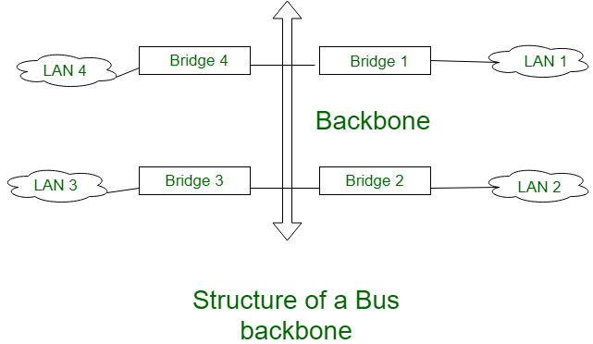
Bus Backbone:
In Bus backbone the topology used for the backbone is bus topology.

Slide 86
Bus backbones are normally used as a distribution backbone to connect different buildings in an organization. Each building can comprise either a single LAN or another backbone (normally a star backbone). A good example of a bus backbone is one that connects single- or multiple-floor buildings on a campus. Each single-floor building usually has a single LAN. Each multiple-floor building has a backbone (usually a star) that connects each LAN on a floor. A bus backbone can interconnect these LANs and backbones.

Slide 87
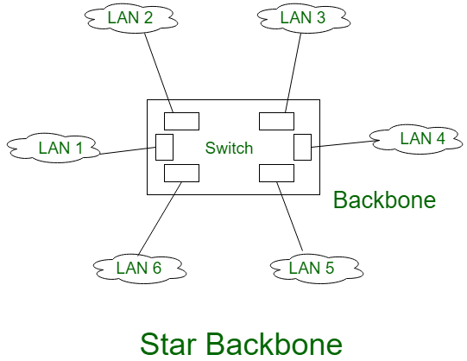
Star Backbone: The topology of this backbone is star topology.

Slide 88
Above figure shows the Star backbone in this configuration, the backbone is simply a switch which is used to connect various LANs. The switch does the job of backbone and connect the LANs as well. This type of backbone are basically used as distribution backbone inside a building.

Slide 89
Transmission media
For any networking to be effective ,raw stream of data to be transported from one device to other over some medium. Various media can be used for transfer data.
Transmission media
Guided
unguided
Coaxial
Fiber Optics
Twisted
Radio Signal
Microwaves
Infrared
Baseband
Unshielded Twisted Pair (UTP)
Broadband
Shielded Twisted Pair (STP)

Slide 90
Guided Media:
In this the data is transmitted through cabling system that has a
Fixed path
Features:
High Speed
Secure
Used for comparatively shorter distances

Slide 91
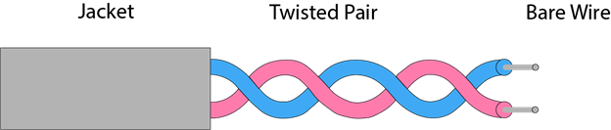
There are 3 major types of Guided Media
Twisted pair:
Twisted pair is a physical media made up of a pair of cables twisted with each other.
A twisted pair cable is cheap as compared to other transmission media.
Installation of the twisted pair cable is easy
The frequency range for twisted pair cable is from 0 to 3.5KHz.
A twisted pair consists of two insulated copper wires arranged in a regular spiral pattern.

Slide 92
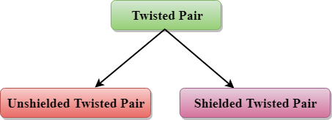
Types of Twisted pair:
Unshielded Twisted Pair:
A unshielded twisted pair widely used in telecommunication. Following are the categories of the unshielded twisted pair cable:
Category 1: Category 1 is used for telephone lines that have low-speed data.
Category 2: It can support upto 4Mbps.

Slide 93
Category 3: It can support upto 10 Mbps for upto 100 meters.
Category 4: It is used in token ring network. It support 16 Mbps upto 100 meters.
Category 5: It is used in Ethernet based lan. It contains two twisted pair.It supports 100Mbps for upto 100 meters.
Category 5e: It is used in Ethernet based lan. CAT5e contains four twisted pairs. It support 1Gbps for 100 meters.
Category 6: Used in Ethernet based lan and data center network.It contains four tightly wound twisted pair. It support 1Gbps for upto 100 meters and 10 Gbps for up to 50 meters.

Slide 94
Advantage:
It is cheap
Installation is easy
It can be used for high speed lan
Disadvantage:
This cable can only be used for shorter distance because of attenuation.

Slide 95
Shielded Twisted Pair:
A shielded twisted pair is a cable that contains the mesh surrounding the wire that allows the higher transmission rate.
Characteristics Of Shielded Twisted Pair:
The cost of the shielded twisted pair cable is not very high and not very low.
An installation of STP is easy.
It has higher capacity as compared to unshielded twisted pair cable.
It has a higher attenuation.
It is shielded that provides the higher data transmission rate.
Disadvantages:
It is more expensive as compared to UTP and coaxial cable.
It has a higher attenuation rate.

Slide 96
Coaxial Cable
Coaxial cable is very commonly used transmission media, for example, TV wire is usually a coaxial cable.
The name of the cable is coaxial as it contains two conductors parallel to each other.
It has a higher frequency as compared to Twisted pair cable.
The inner conductor of the coaxial cable is made up of copper, and the outer conductor is made up of copper mesh. The middle core is made up of non-conductive cover that separates the inner conductor from the outer conductor.
The middle core is responsible for the data transferring whereas the copper mesh prevents from the EMI(Electromagnetic interference)

Slide 97
Coaxial cable is of two types:
Baseband transmission: It is defined as the process of transmitting a single signal at high speed.
Broadband transmission: It is defined as the process of transmitting multiple signals simultaneously.
Advantages Of Coaxial cable:
The data can be transmitted at high speed.
It has better shielding as compared to twisted pair cable.
It provides higher bandwidth.
Disadvantages Of Coaxial cable:
It is more expensive as compared to twisted pair cable.
If any fault occurs in the cable causes the failure in the entire network.

Slide 98
